Slide 1


Team 3
Bill Dimou
Olga Kyriazi
Sotiris Simos
Chris Theodoropoulos
Nikolas – Marios Tsarouchas

Slide 2
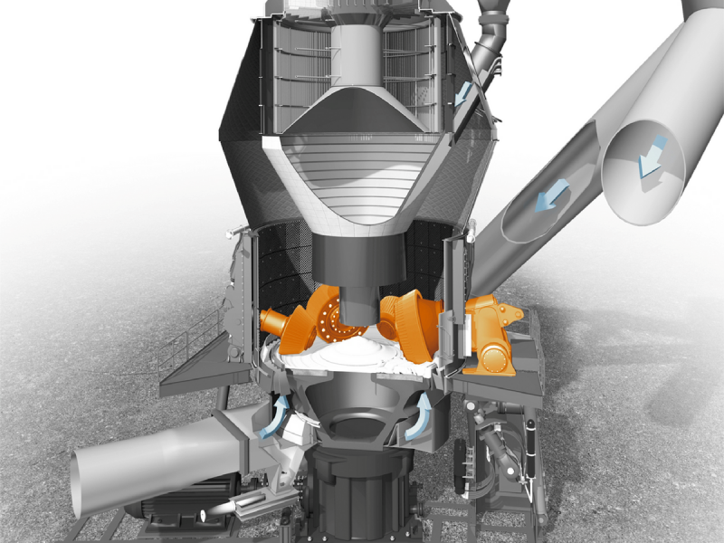
Optimization of Titan’s Vertical cement mill operation
Block 1
Predict the energy expenditure of the separator
Block 2
Predict differential pressure in the mill

Slide 3
Contents
Exploratory Data Analysis
Data Visualization
Input – Output correlations
Delay Times
Data Cleaning
Columns
Values Format
Normal Operating Conditions
Cement Type Split
Data Manipulation
Resampling & Imputation (Missing Values)
Time delay adjustment
Feature Scaling
Predictive Models
Models investigated
Genetically Optimized MLP
Comparative Analysis
Multi Models
Prediction in t+5
Extra Input Variables Investigation
Closing Remarks

Slide 4
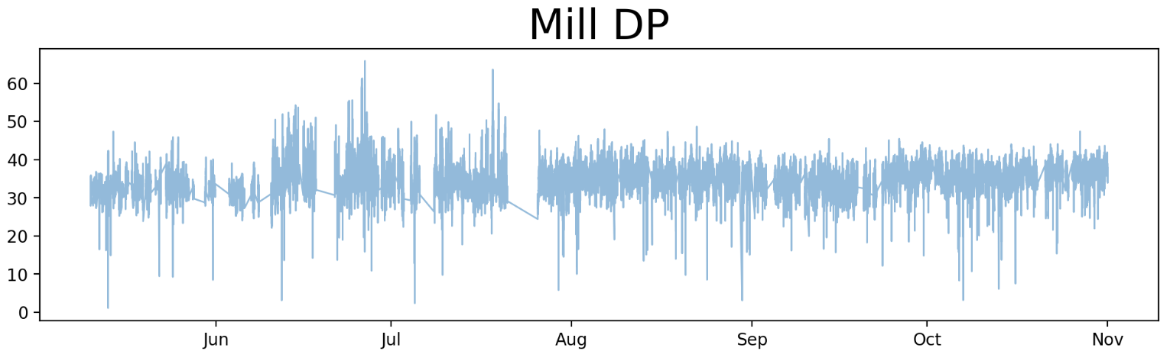
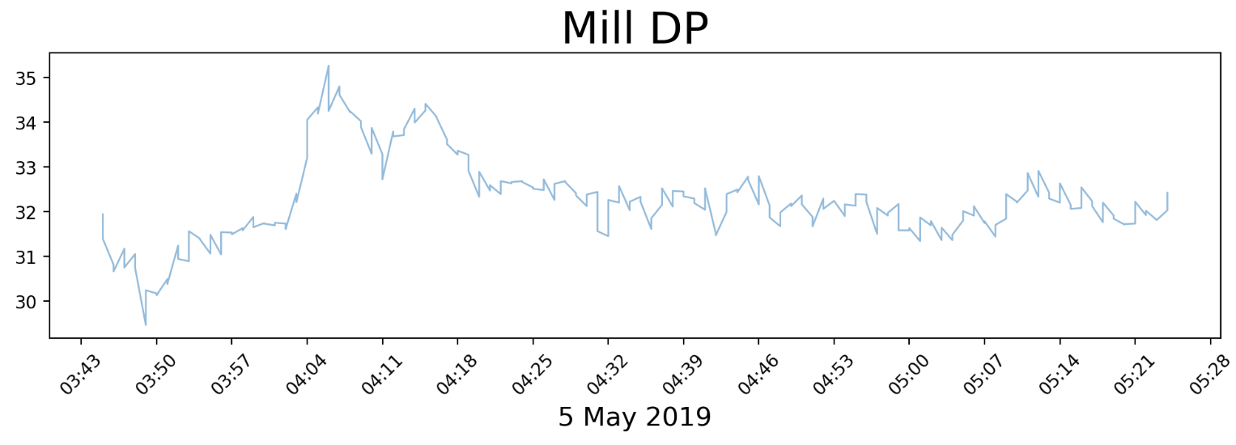
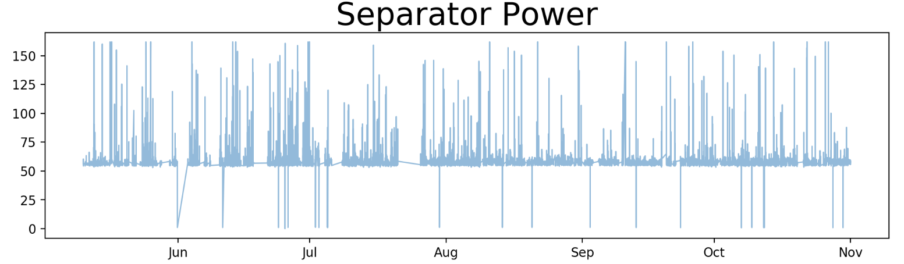
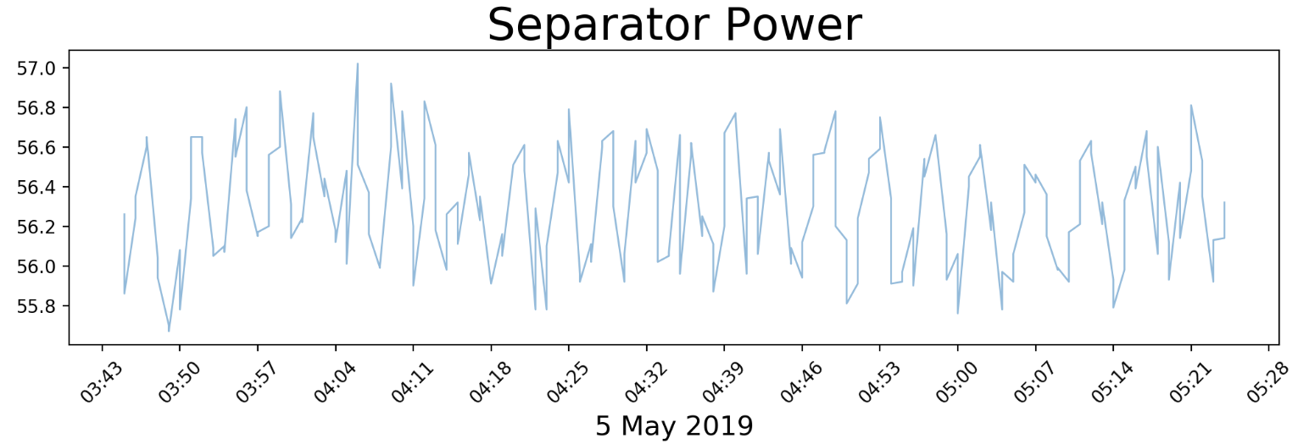
Exploratory Data Analysis Data Visualization

Slide 5
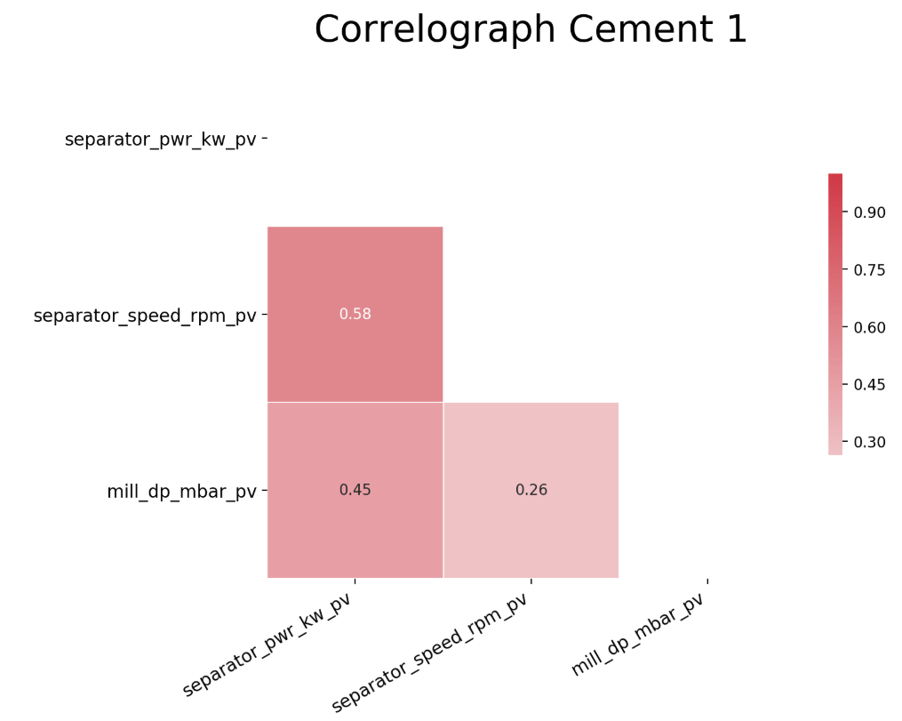
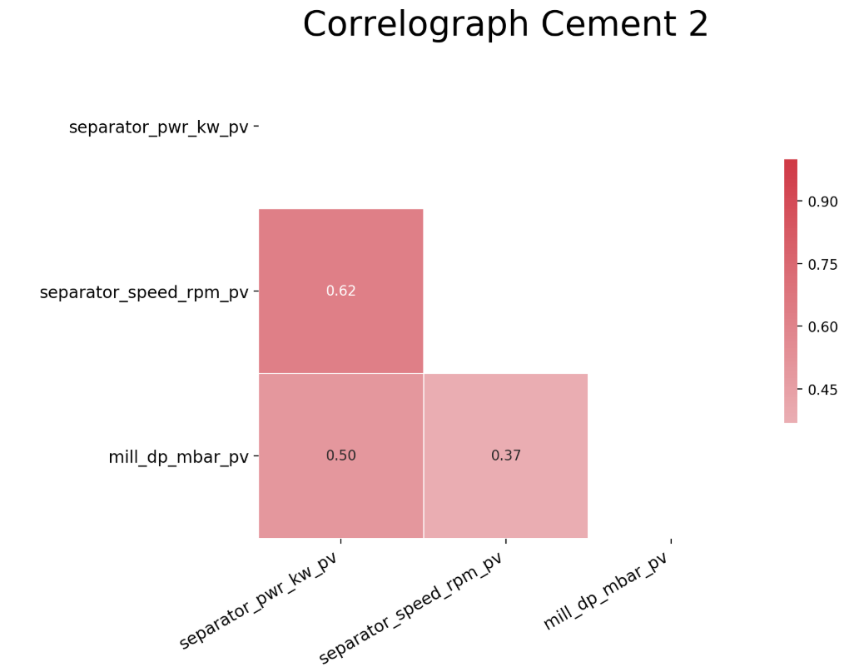
Exploratory Data Analysis Input – Output Correlations
Block 1

Slide 6
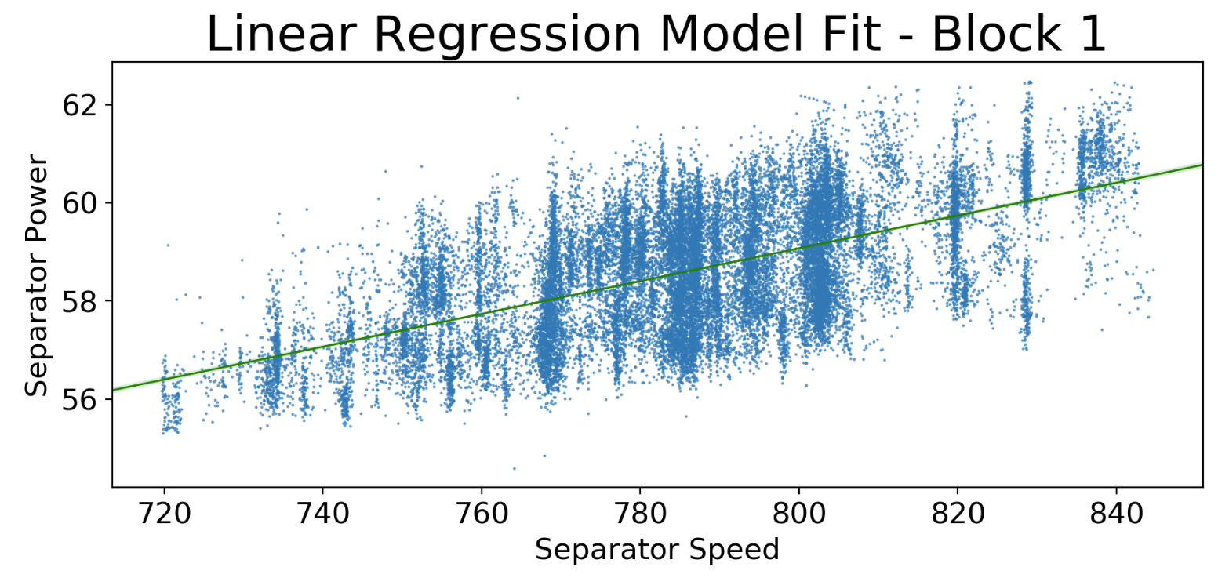
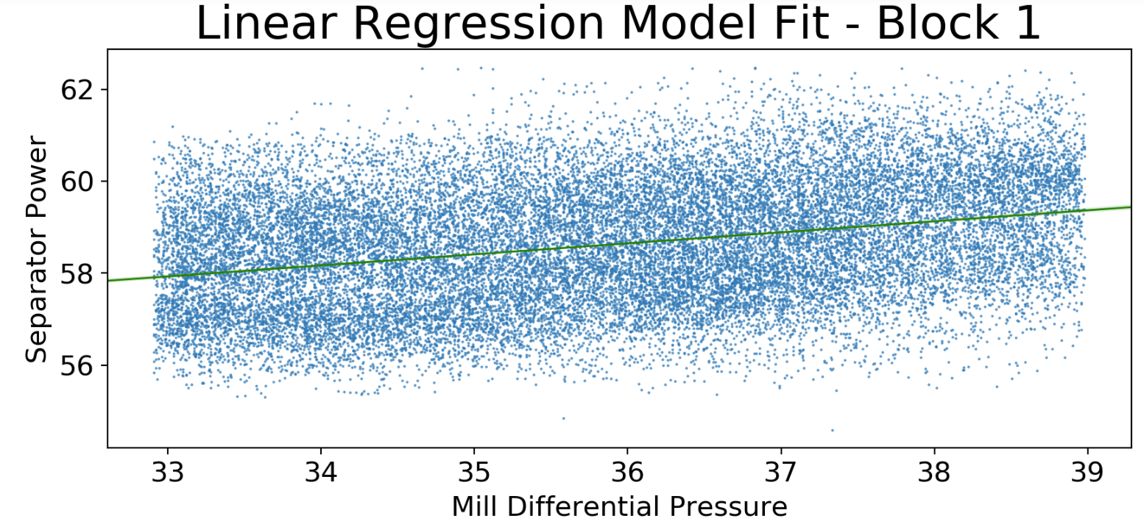
Exploratory Data Analysis Input – Output Correlations
Block 1
Medium strength linear relationship

Slide 7
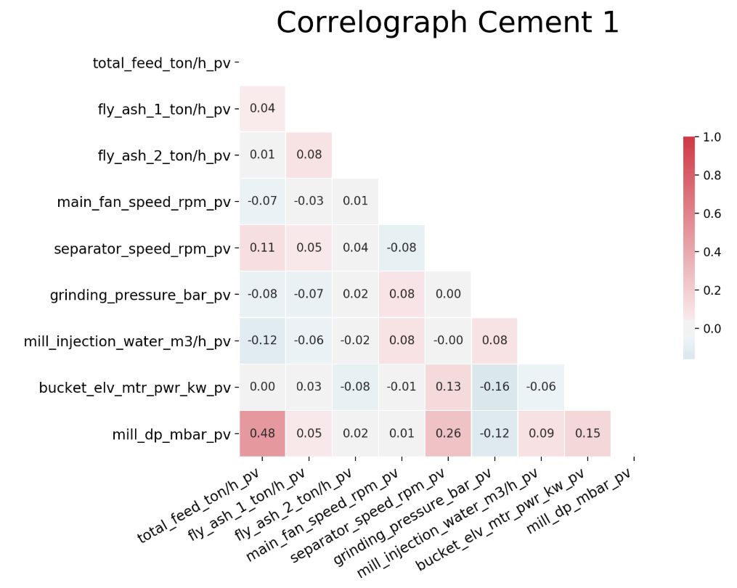
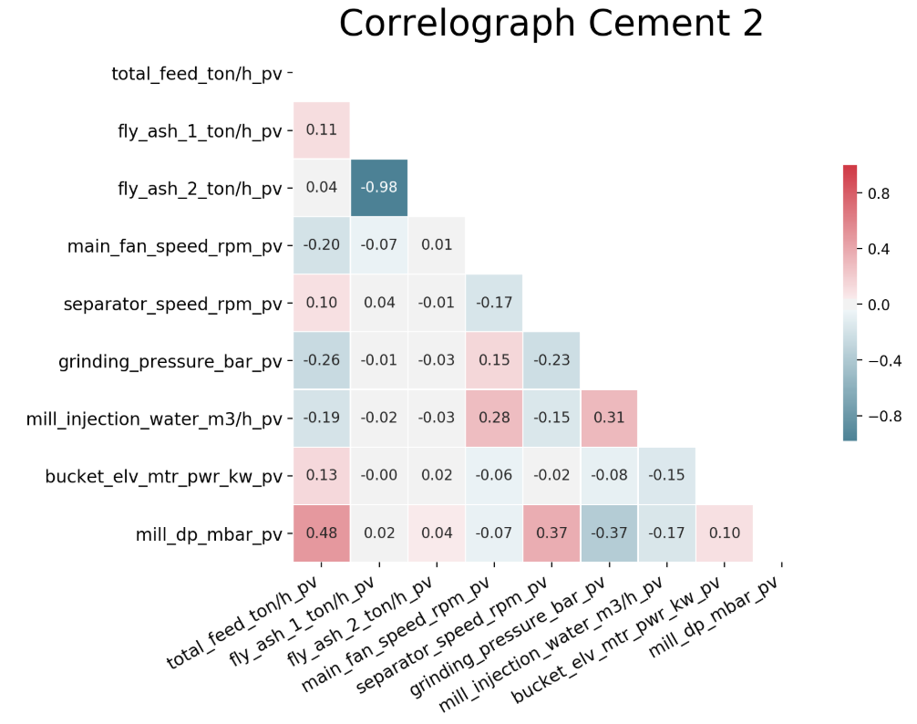
Exploratory Data Analysis Input – Output Correlations
Block 2

Slide 8
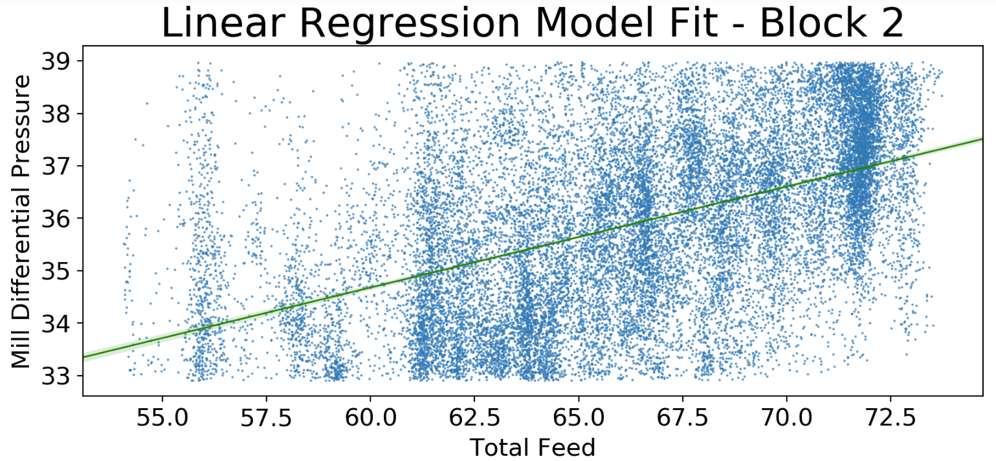
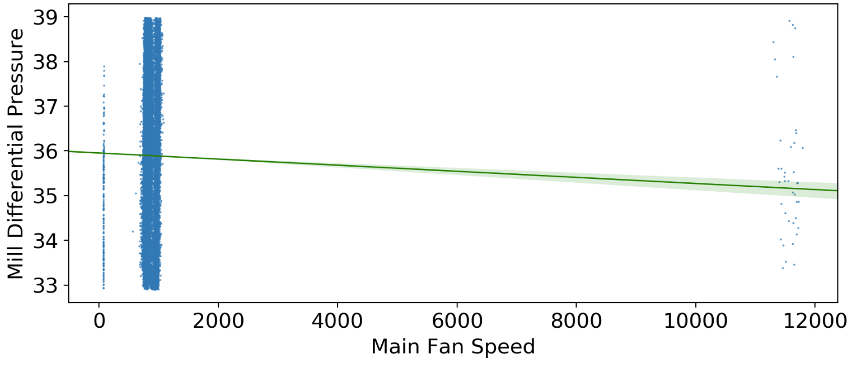
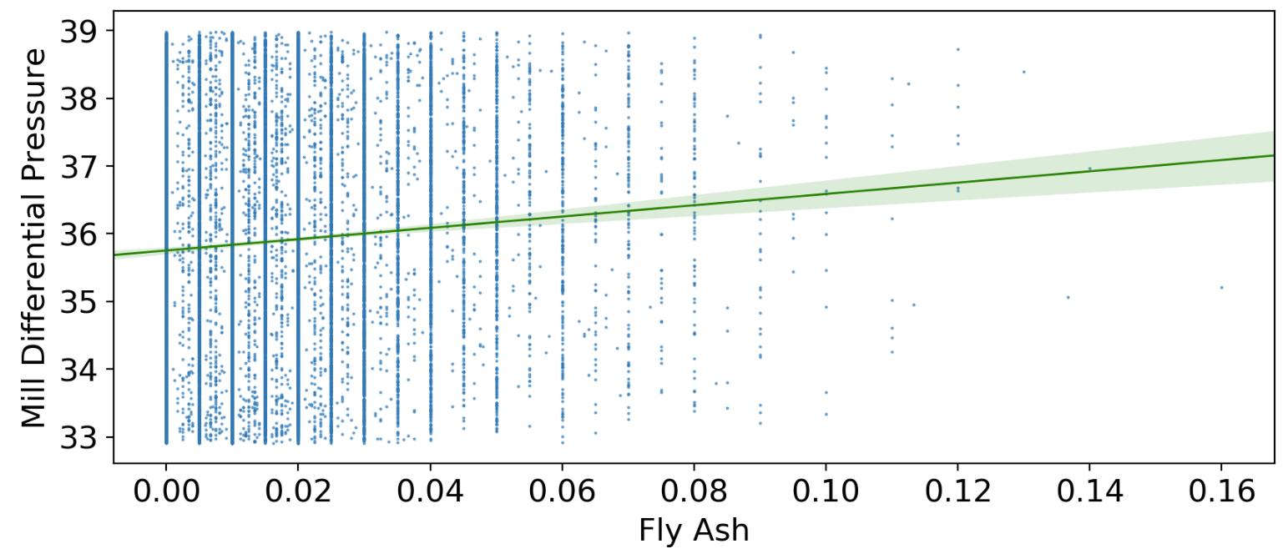
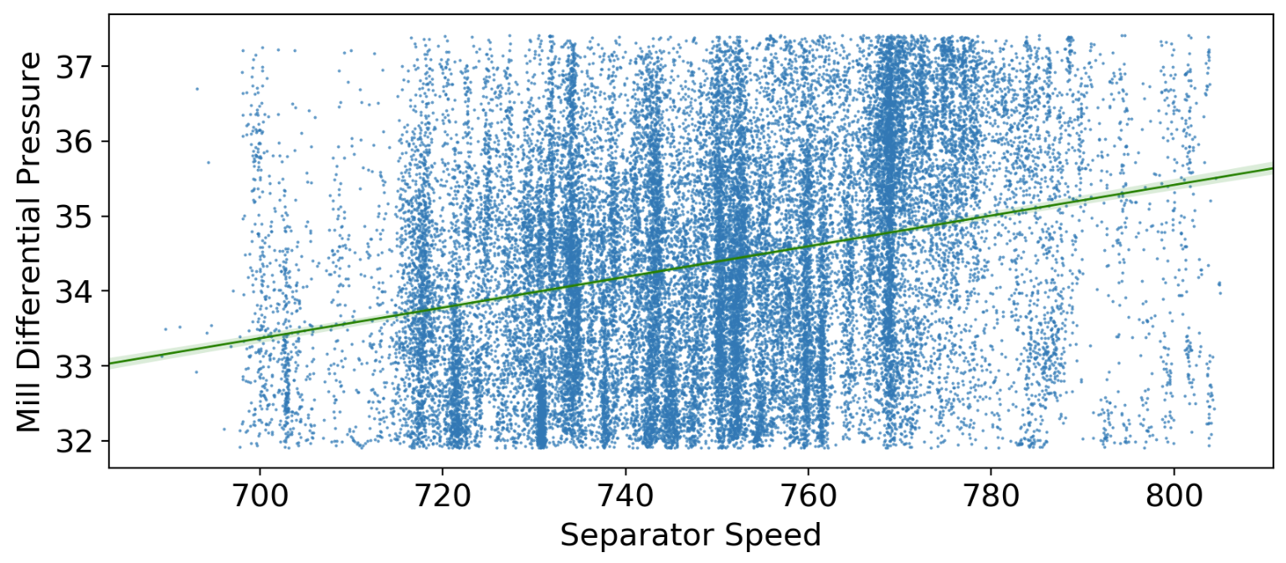
Exploratory Data Analysis Input – Output Correlations
Block 2
Weak or no linear relationship

Slide 9
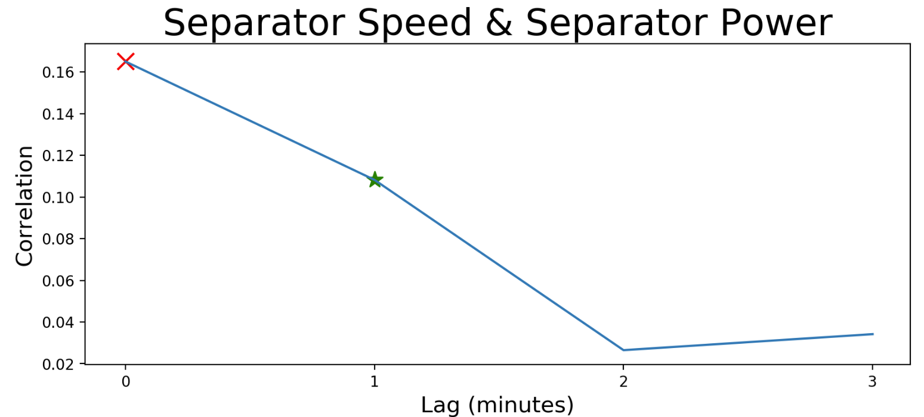
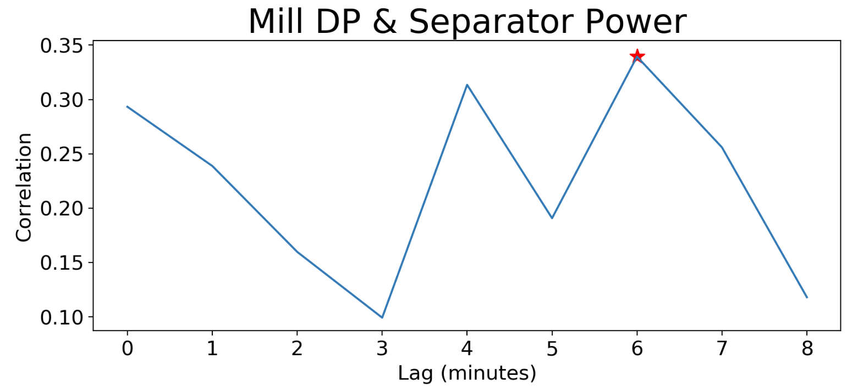
Exploratory Data Analysis Delay Times
Block 1
Cross correlation visualization to confirm given delay times

Slide 10
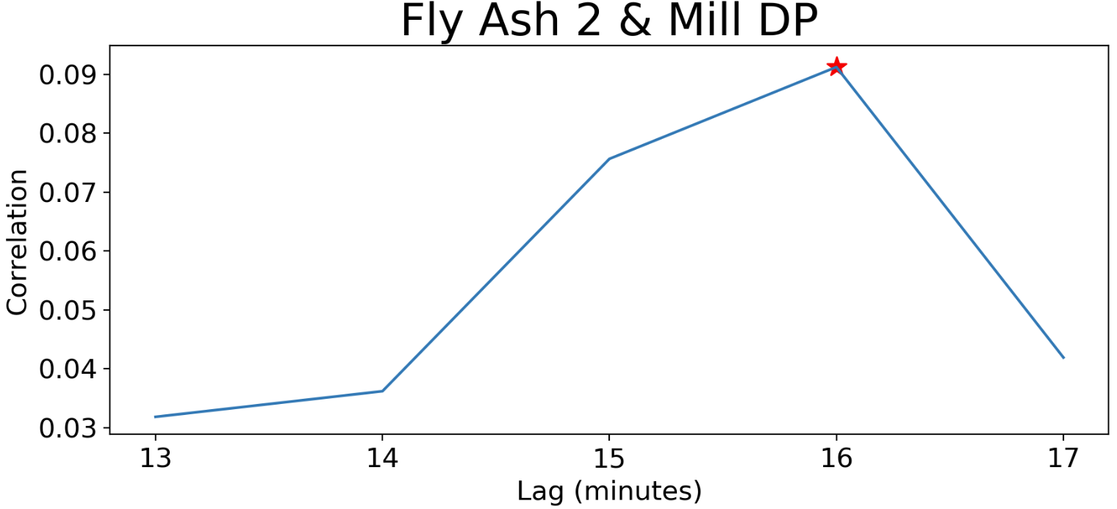
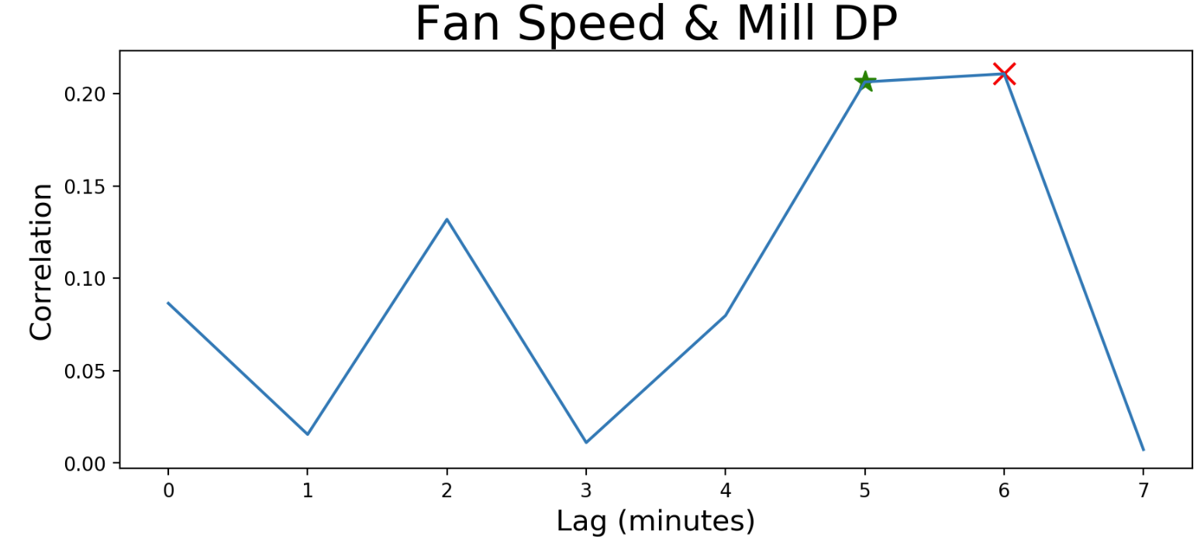
Exploratory Data Analysis Delay Times
Block 2
Cross correlation visualization to confirm given delay times
Variable | Delay Time (min) |  | Variable | Delay Time (min)
Total feed | 5 |  | Water injection | 3
Fly ash 1 | 15 |  | Grinding pressure | 4
Separator speed | 3 |  | Bucket elevator | 4

Slide 11
Data Cleaning
Columns
Values Format
Column names’ regularization
Columns’ merge (July)
Extra columns selection (July - October)
Strings to floats
Datetime objects
Month vs day first
Dates as indices
Data frames concatenation
Data frame size: 346915 x 92

Slide 12
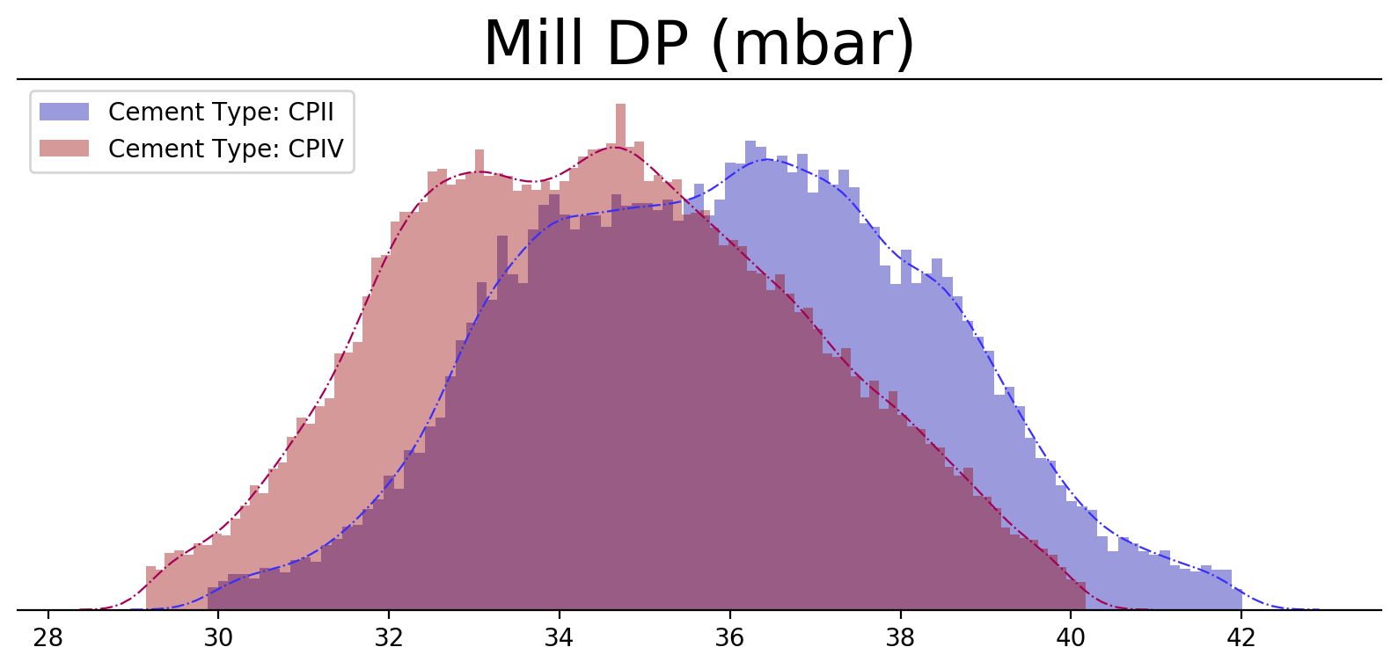
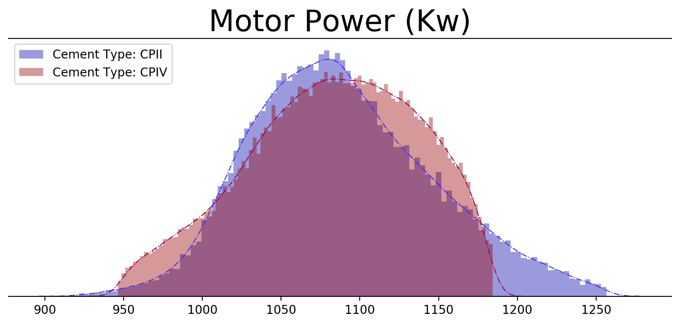
Data Cleaning Normal Operating Conditions
Frequency Distribution Plots

Slide 13
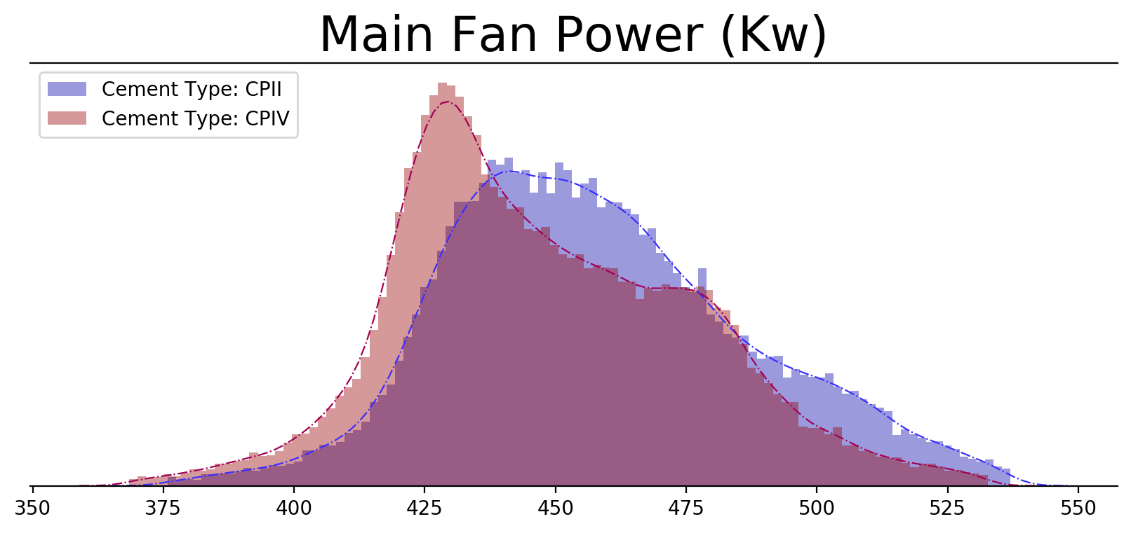
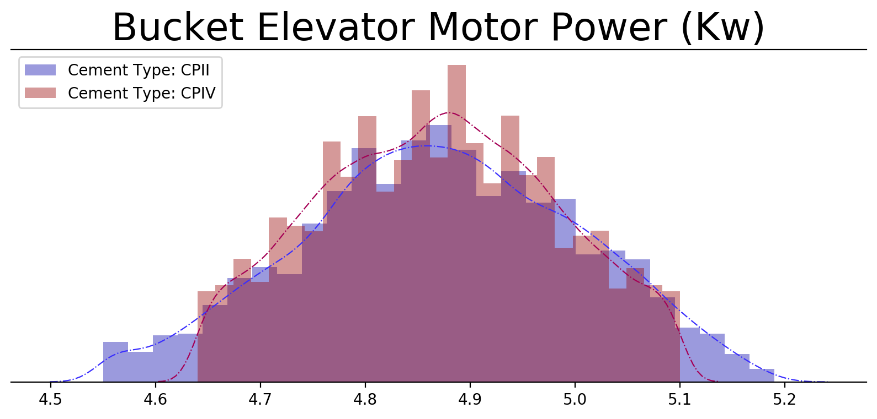
Data Cleaning Normal Operating Conditions
Frequency Distribution Plots

Slide 14
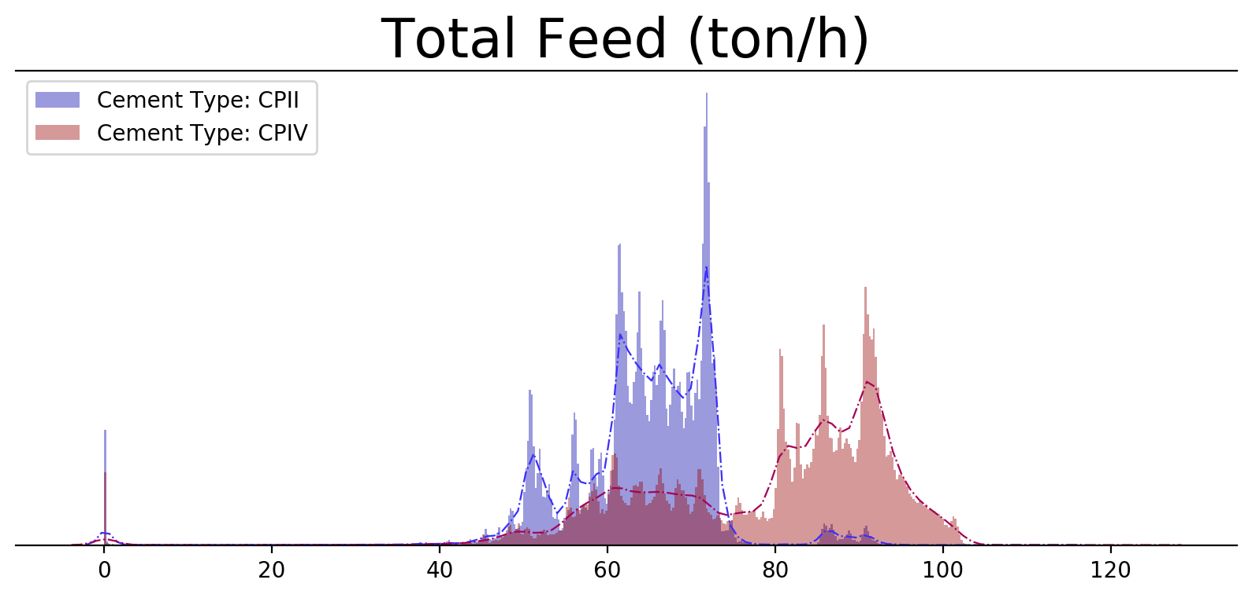
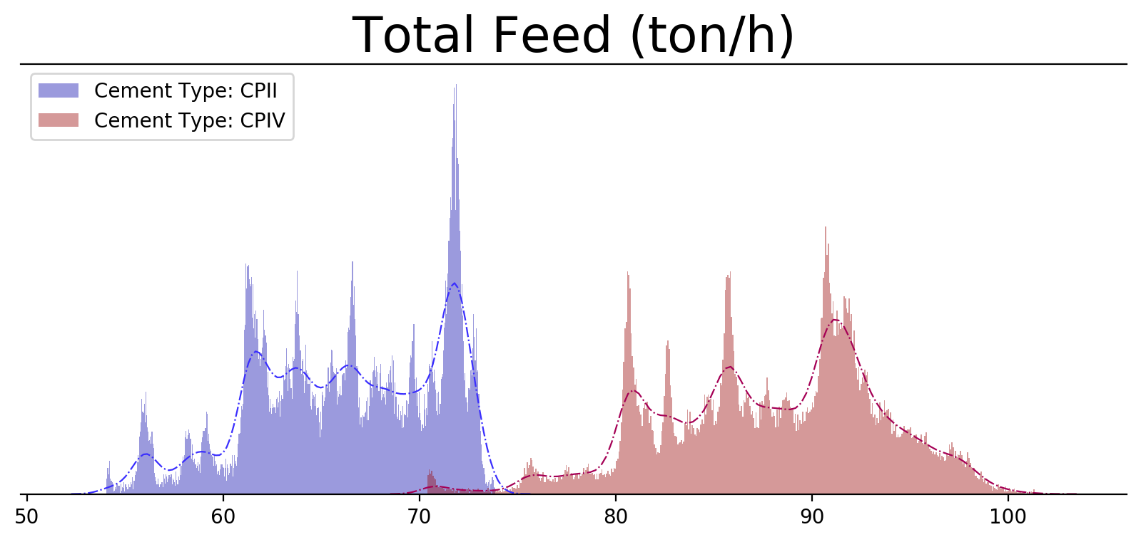
Data Cleaning Cement Type Split
Frequency Distribution Plots
Before
After
Data frames size
Cement type CPII : 67790 x 92
Cement type CPIV: 112941 x 92

Slide 15
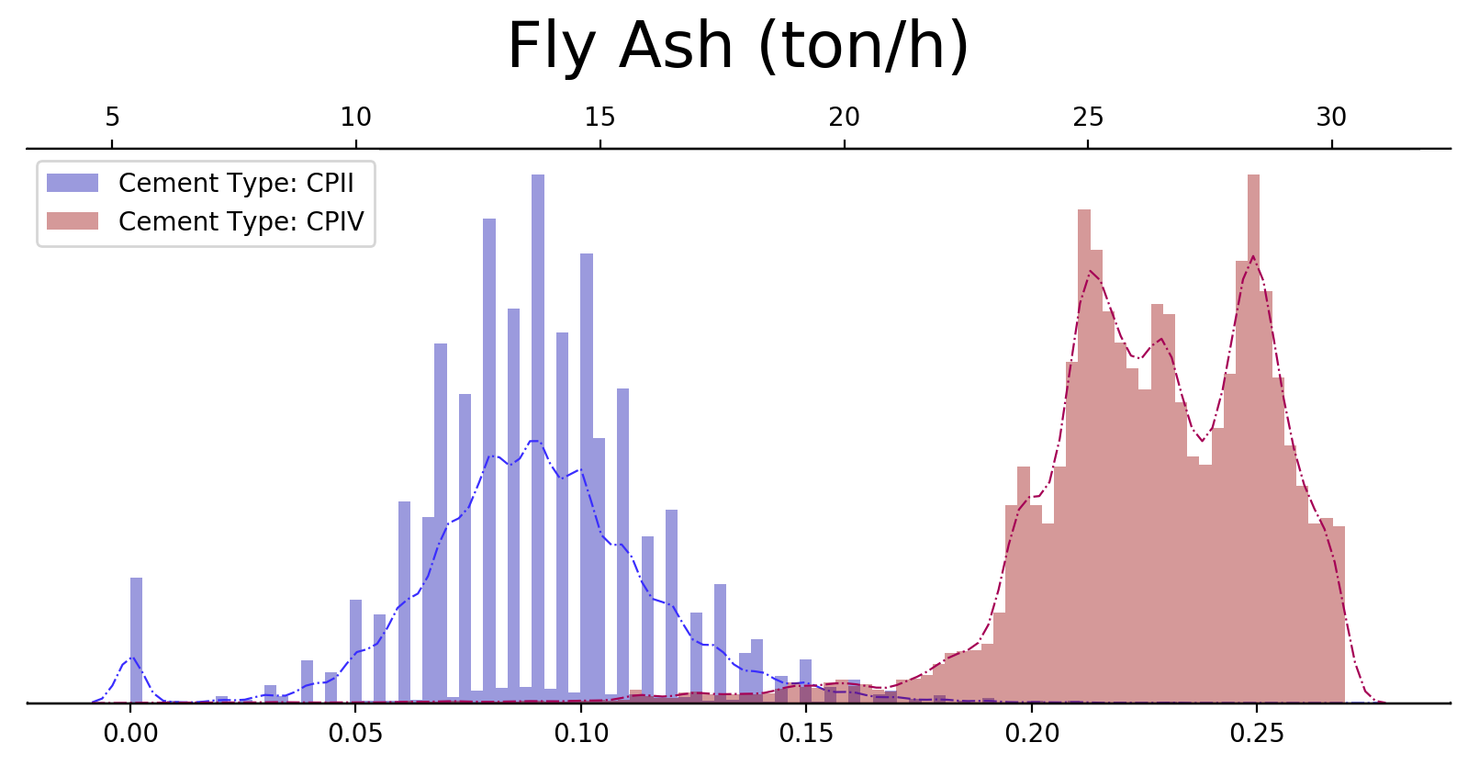
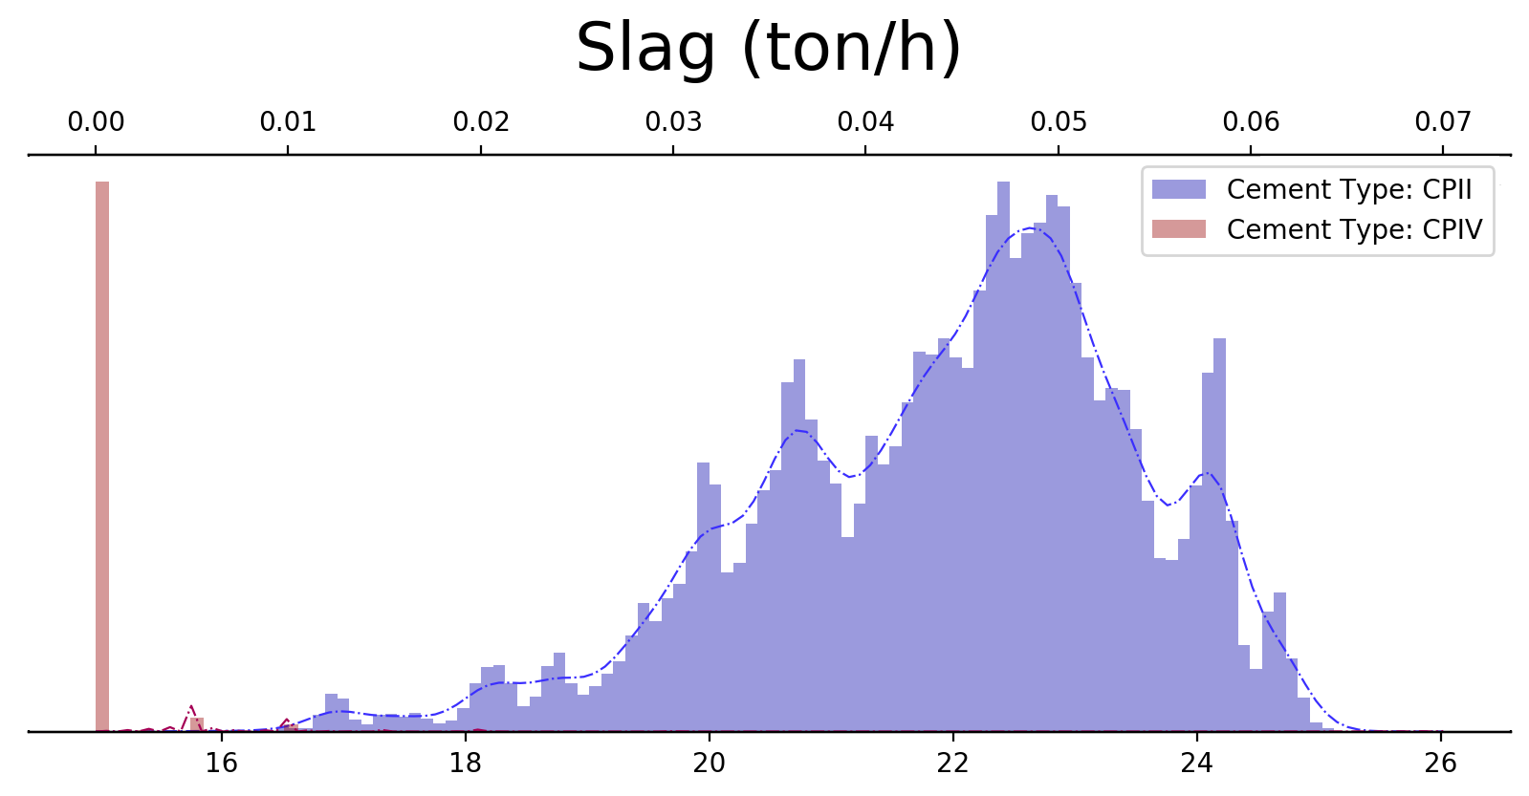
Data Cleaning Cement Type Split
Confirming our cut-off limit with frequency distribution plots:

Slide 16
Data Manipulation Resampling & Imputation (Missing Values)
Data frames size
Cement type CPII : 246455 x 92
Cement type CPIV: 251324 x 92
Cement type CPII : 39430 x 92
Cement type CPIV: 73368 x 92
Cement type CPII : 39163 x 92
Cement type CPIV: 73368 x 92
60 seconds resampling
Delete rows with NaNs (threshold = 5)
‘Main fan speed’ column: delete rows with NaNs (threshold = 5)
Linear interpolation

Slide 17
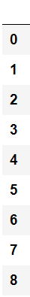
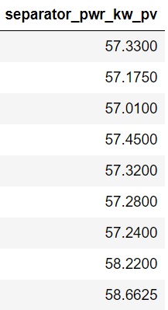
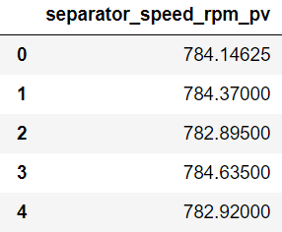
Data Manipulation Time Delay Adjustment
If a change in separator speed leads to a change in separator power with a 3 minutes delay…
Data frames final length
Block 1
Cement type CPII : 35545 x 6
Cement type CPIV: 66932 x 6
Block 2
Cement type CPII : 32535 x 11
Cement type CPIV: 61072 x 11

Slide 18
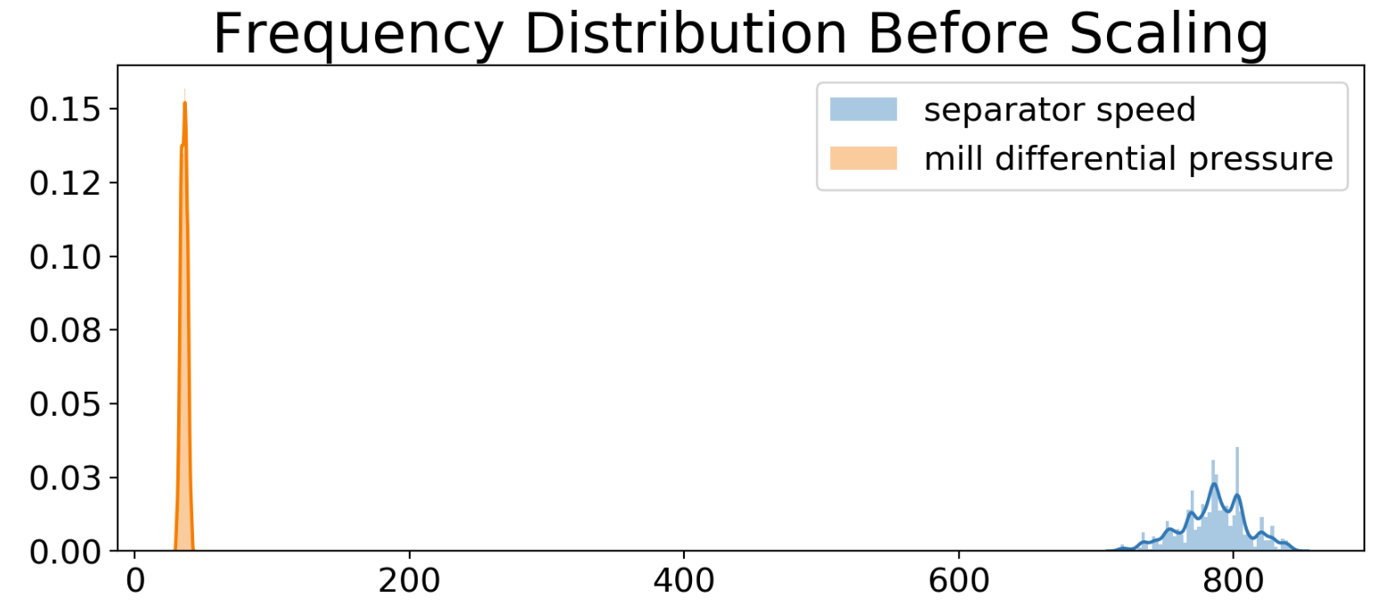
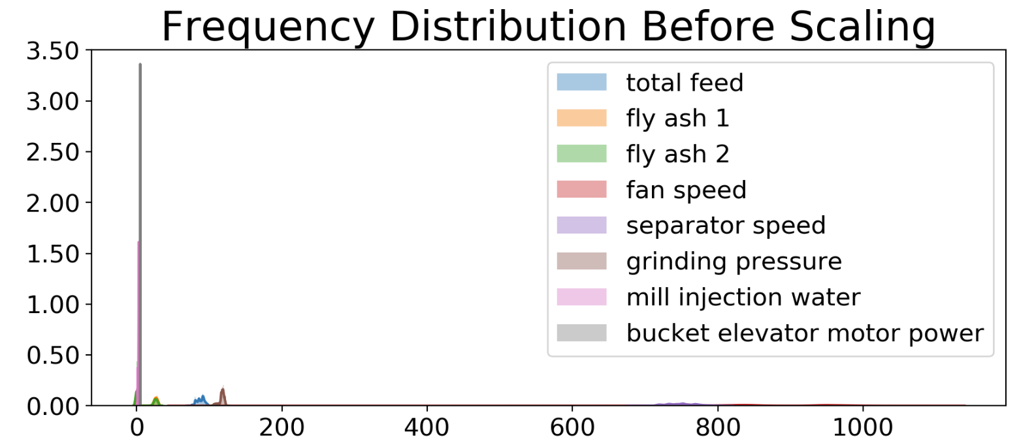
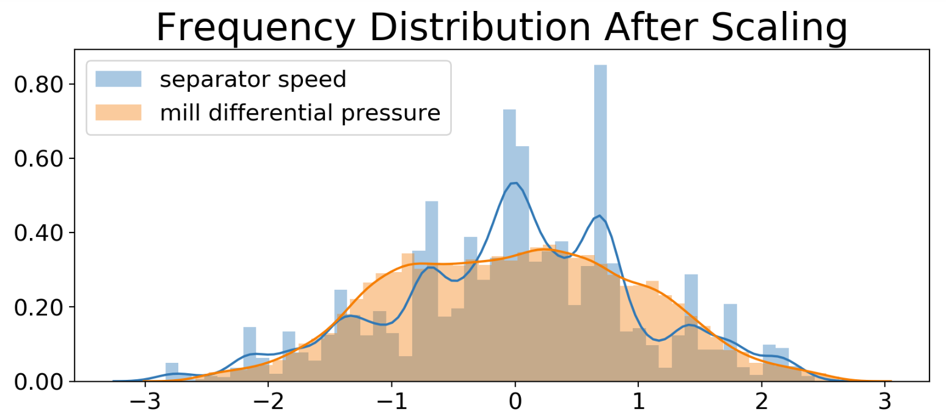
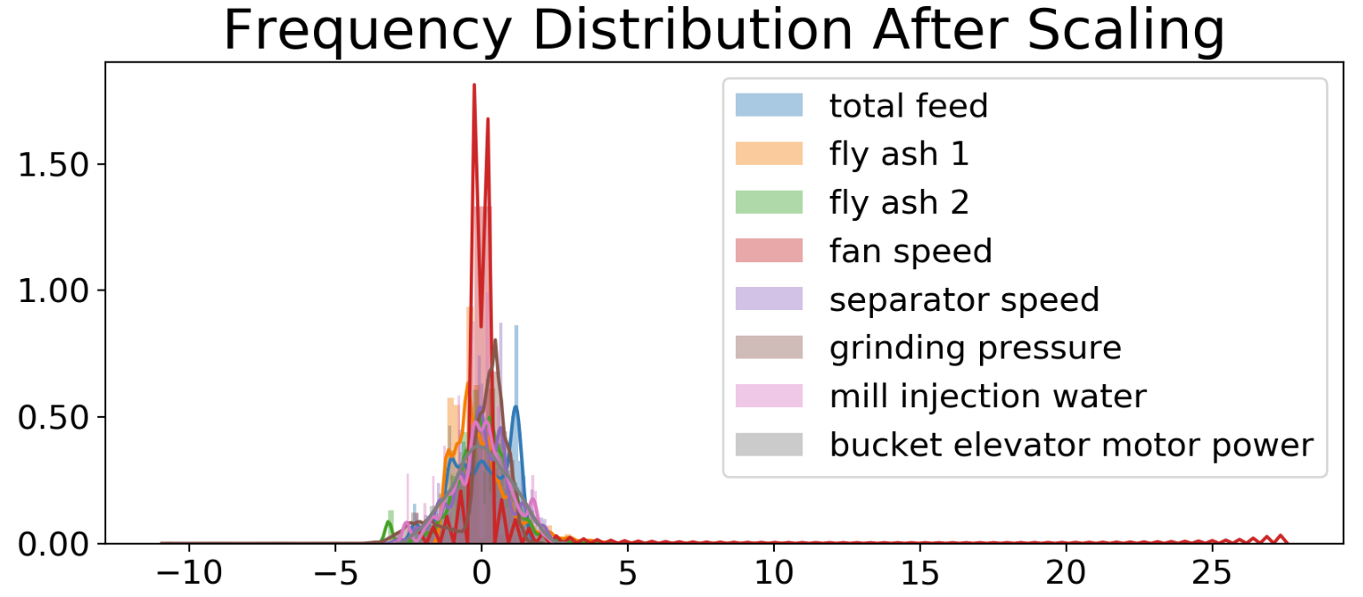
Data Manipulation Feature Scaling
Block 1
Block 2

Slide 19

Predictive Models
Linear Models
Linear Regression
Lasso Regression
Ridge Regression
Decision Trees
Random Forest
LGBM Regressor
MLP Regression
SVR
KNN
XG Boost
GNN
STACK

Slide 20
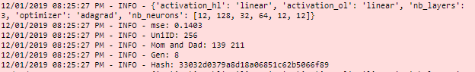
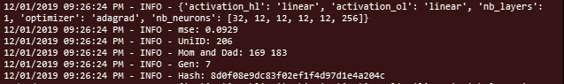
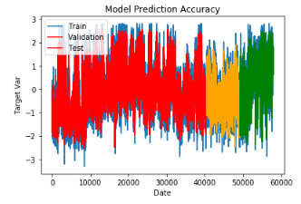
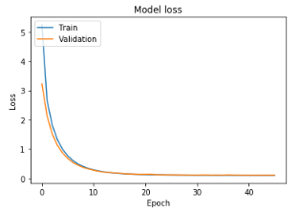
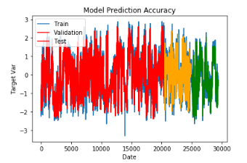
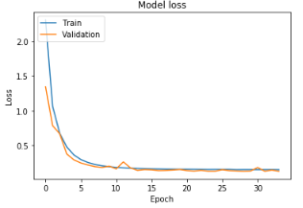
Predictive Models Genetically Optimized MLP
Block 1
Cement Type I
Cement Type II

Slide 21
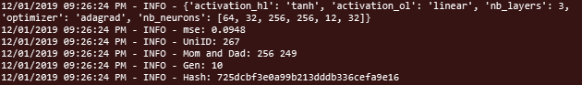
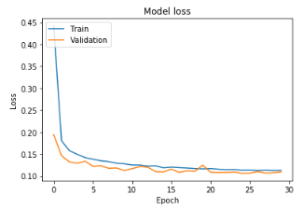
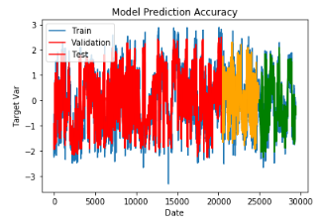
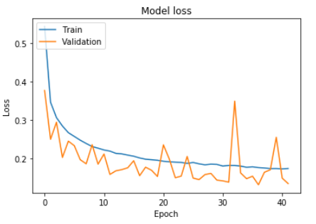
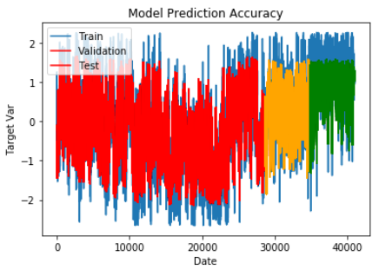
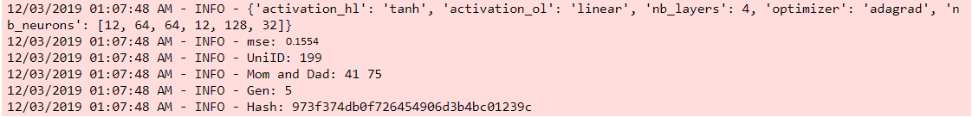
Predictive Models Genetically Optimized MLP
Block 2
Cement Type I
Cement Type II

Slide 22
Predictive Models Comparative Analysis
Block 1
Cement Type I
Model | MAE | MSE | R^2
Linear Regression | 0.298 | 0.158 | 0.918
Lasso Regression | 0.312 | 0.169 | 0.912
Ridge Regression | 0.298 | 0.158 | 0.918
Decision Tree | 0.293 | 0.159 | 0.918
Random Forest | 0.282 | 0.148 | 0.923
LGBM Regressor | 0.279 | 0.144 | 0.926
MLP Regression | 0.292 | 0.153 | 0.921
SVR | 0.286 | 0.150 | 0.922
KNN | 0.288 | 0.154 | 0.921
XG | 0.279 | 0.143 | 0.926
Averaging model | 0.268 | 0.129 | 0.933
Stack | - | 0.123 | -

Slide 23
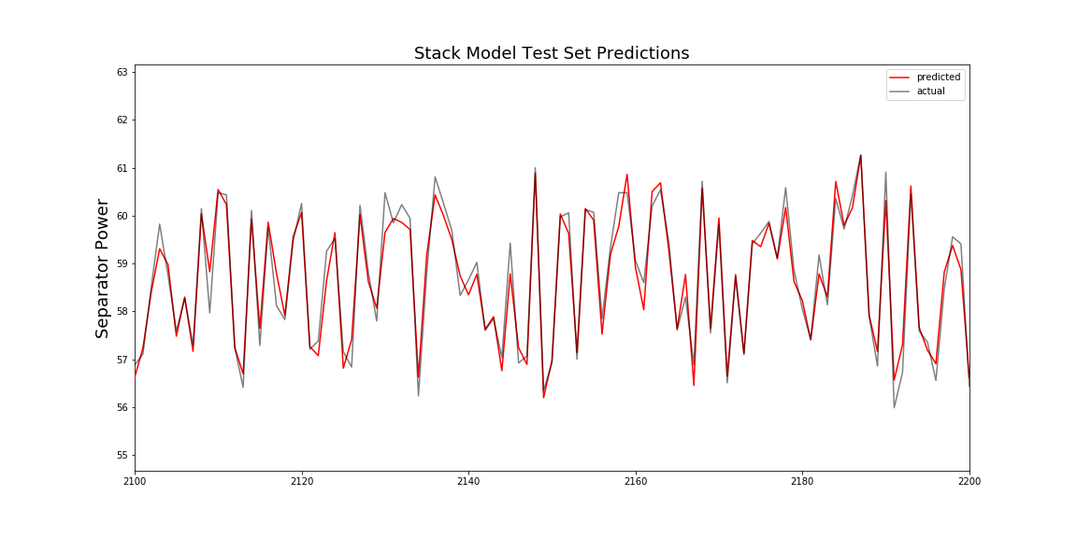
Predictive Models Multi Models
Block 1
Cement Type I
Model Equation: w₁* LGBM + w₂ * SVR + w₃ * RF + w₄ * XG

Slide 24
Predictive Models Comparative Analysis
Block 1
Cement Type II
Model | MAE | MSE | R^2
Linear Regression | 0.247 | 0.100 | 0.873
Lasso Regression | 0.263 | 0.114 | 0.856
Ridge Regression | 0.247 | 0.101 | 0.873
Decision Tree | 0.243 | 0.101 | 0.874
Random Forest | 0.235 | 0.094 | 0.882
LGBM Regressor | 0.232 | 0.092 | 0.885
MLP Regression | 0.242 | 0.097 | 0.878
SVR | 0.234 | 0.094 | 0.882
KNN | 0.241 | 0.099 | 0.876
XG | 0.234 | 0.094 | 0.882
Averaging model | 0.230 | 0.091 | 0.886
Stack | - | 0.080 | -

Slide 25
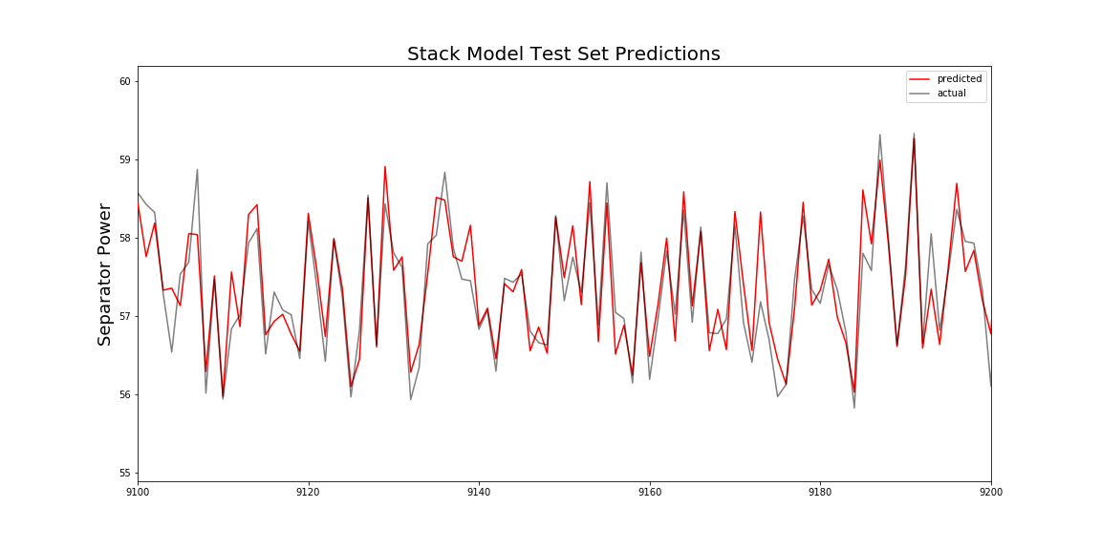
Predictive Models Multi Models
Block 1
Cement Type II
Model Equation: w₁* LGBM + w₂ * SVR + w₃ * RF + w₄ * XG

Slide 26
Predictive Models Comparative Analysis
Block 2
Cement Type I
Model | MAE | MSE | R^2
Random Forest | 0,454 | 0,434 | 0,918
LGBM Regressor | 0,450 | 0,423 | 0,919
MLP Regression | 0,451 | 0,421 | 0,920
SVR | 0,454 | 0,431 | 0,918
Knn | 0,561 | 0,619 | 0,918
Xg Boost | 0,450 | 0,424 | 0,919
Averaging model | 0,446 | 0,416 | 0,921
Stack |  | 0,415

Slide 27
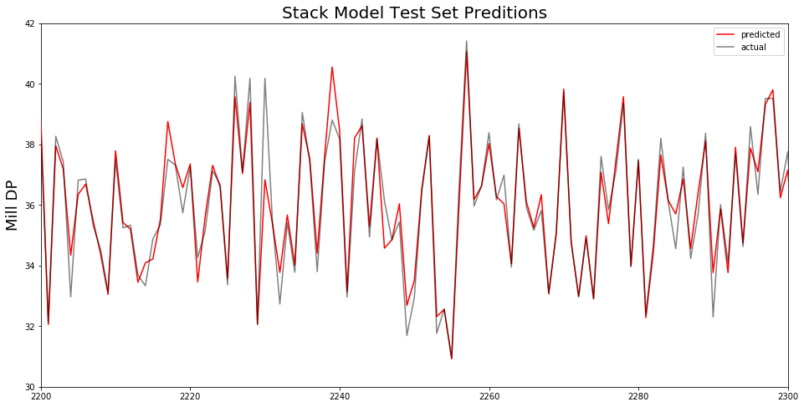
Predictive Models Multi Models
Block 2
Cement Type I
Model Equation: w₁ * LGBM + w₂ * SVR + w₃* MLP + w₄ * XG

Slide 28
Predictive Models Comparative Analysis
Block 2
Cement Type ΙI
Model | MAE | MSE | R^2
Random Forest | 0,439 | 0,401 | 0,923
LGBM Regressor | 0,431 | 0,383 | 0,926
MLP Regression | 0,434 | 0,386 | 0,926
SVR | 0,429 | 0,384 | 0,926
Knn | 0,502 | 0,510 | 0,926
Xg Boost | 0,432 | 0,383 | 0,926
Averaging model | 0,428 | 0,379 | 0,928
Stack |  | 0,378

Slide 29
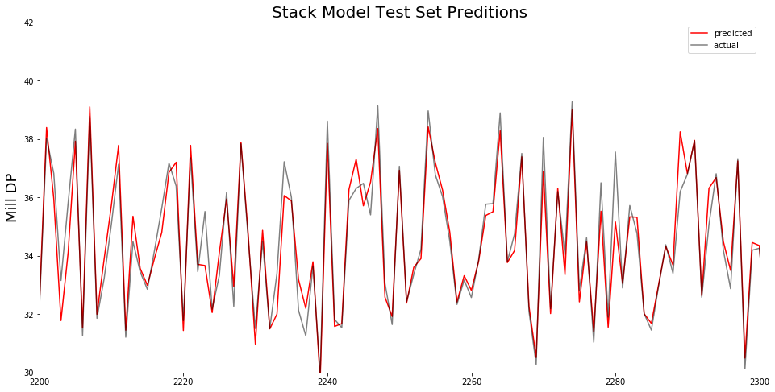
Predictive Models Multi Models
Block 2
Cement Type II
Model Equation: w₁ * LGBM + w₂ * SVR + w₃* MLP + w₄ * XG

Slide 30

Prediction in t+5
Block 1
Cement Type I
Stack Model Predictions

Slide 31

Extra Input Variables Investigation

Slide 32
Closing Remarks
Developed and evaluated machine learning models:
separator consumption in kw
cement mill differential pressure
Combined top 4 models’ predictions → improved predictions
Investigated extra input variables’ correlation
Next steps:
30 seconds resampling
model with new high correlated variables

Slide 33
>> print(‘Thank you!’)

